Slide 1
Synthetic biology platforms for high-resolution access to the modified human proteome
Human proteins exhibit highly complex patterns of posttranslational modifications (PTMs) that govern their structure and function. These modifications are omnipresent in human health and disease. However, technical barriers have limited the study of PTMs which keeps the knowledge of our proteome in a persistent state of “physiological dark matter”.
Over the past decade we have engineered bacterial systems to display all human proteins with programable, site-specific posttranslational modifications. These innovations have allowed unprecedented access to the so called physiological dark matter and shed light onto new frontiers in human disease research.

Slide 2
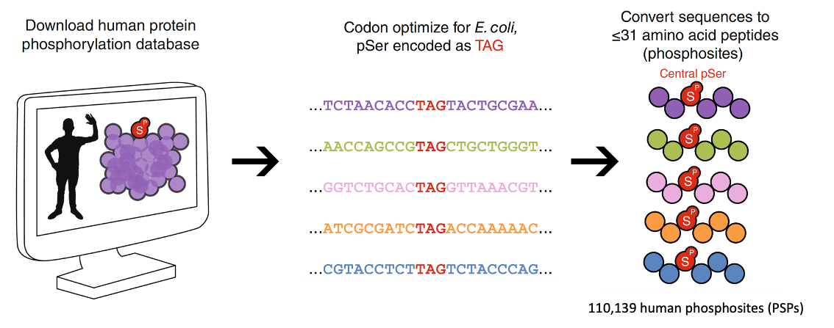
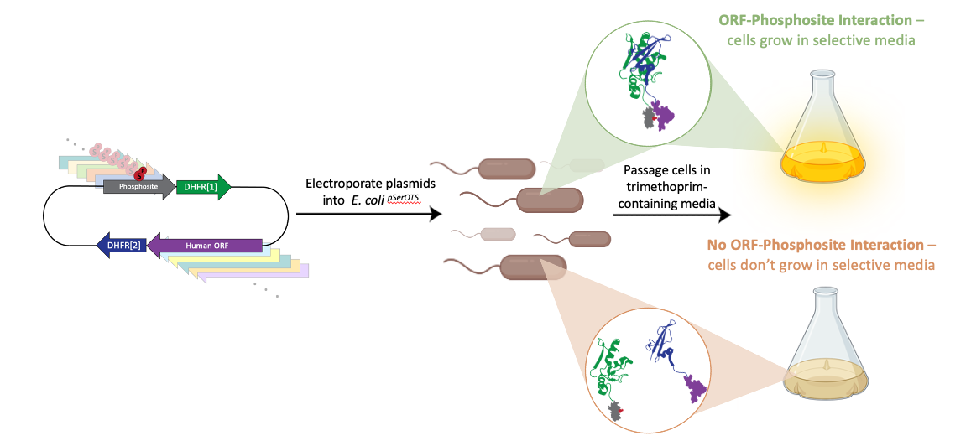
We are seeking talented undergraduates to join a team led by Maya Kornaj (4th year MCDB graduate student) to elucidate novel phospho-binding proteins in the human genome. We perform screens where 8,000 different human proteins can interact with 120,000 phosphosites. The protein interactions take place inside E. coli cells where a single human protein and a single phosphosite are expressed. To screen all possible interactions in a pairwise manner, we need a lot of cells! These screens are enabled by our unique synthetic biology platforms coupled to next generation sequencing and cutting-edge proteomics. Come join our efforts!!
Current Projects:
Uncover how viral pathogens exploit PTMs across the human proteome.
Disentangle PTM driven pathogenesis in neurodegeneration.
Enable genome wide screens of “physiological dark matter”
Jesse Rinehart, PhD. Associate Professor
Yale University School of Medicine
Cellular & Molecular Physiology
Systems Biology Institute
Yale West Campus, Systems Biology Institute, ISTC Building, 3rd Floor
Tracks: Molecular Medicine, Pharmacology, and Physiology (MMPP);
Biochemistry, Quantitative Biology, Biophysics and Structural Biology (BBSB/BQBS)

